Slide 1
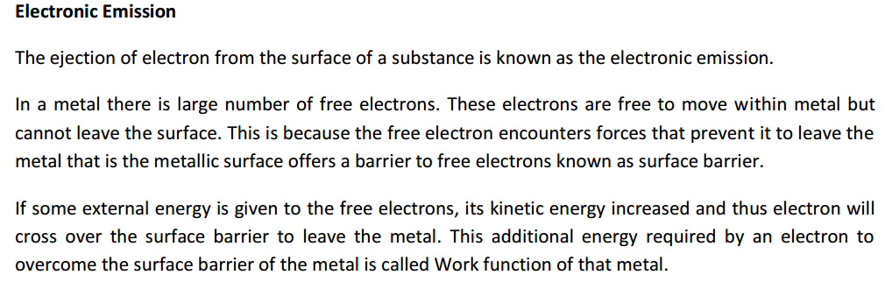
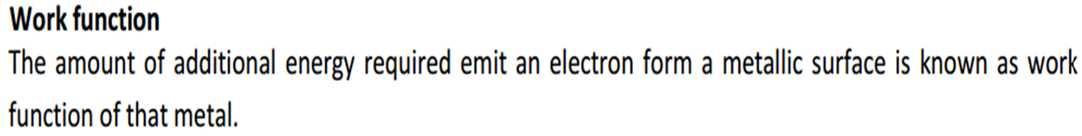

Slide 2
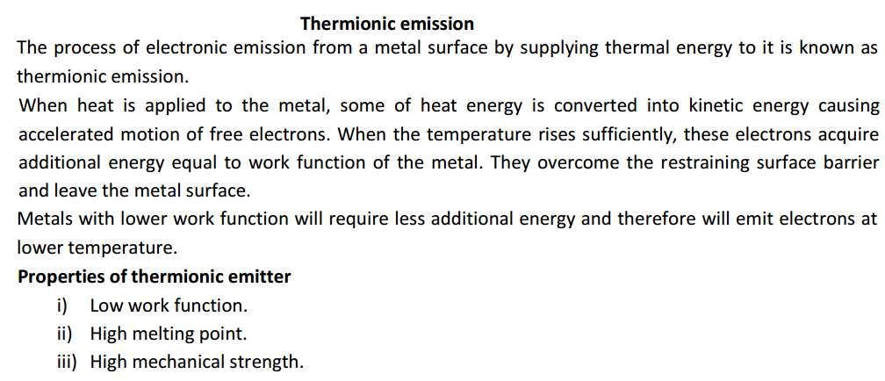

Slide 3
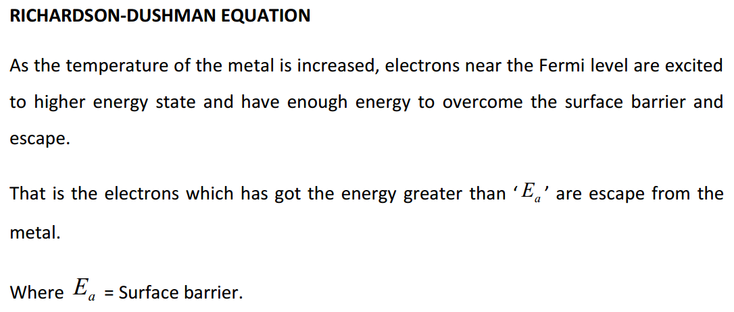

Slide 4
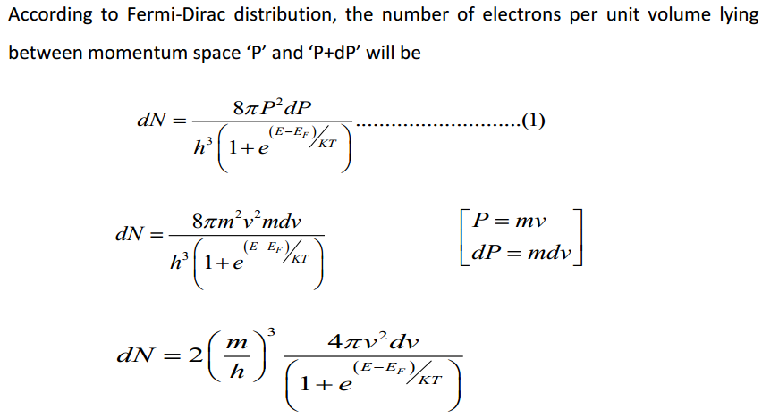

Slide 5
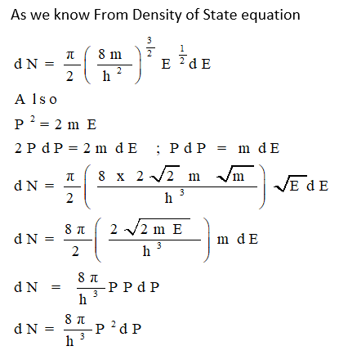

Slide 6
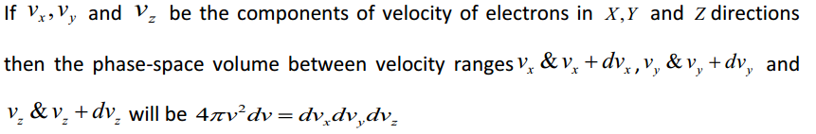
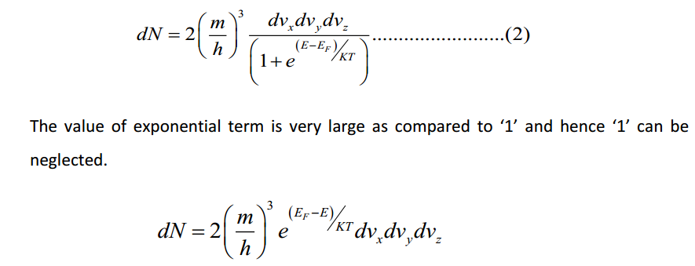

Slide 7
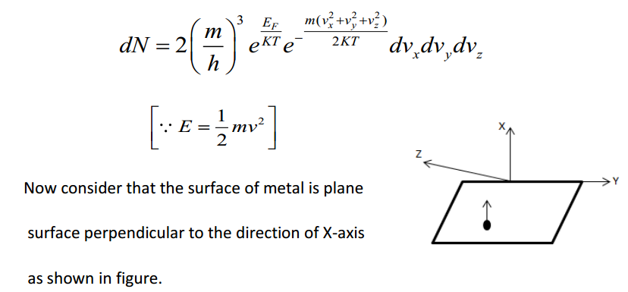

Slide 8
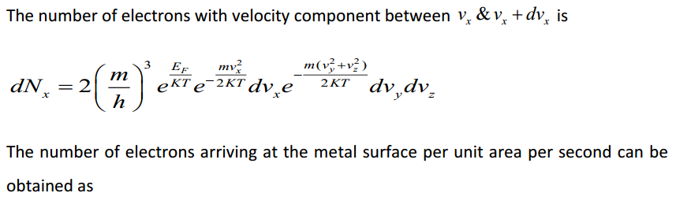


Slide 9
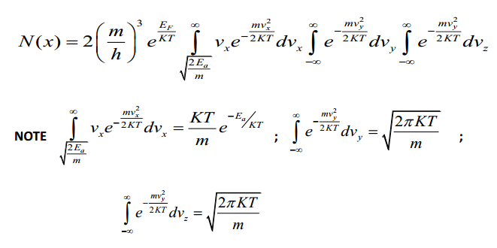

Slide 10
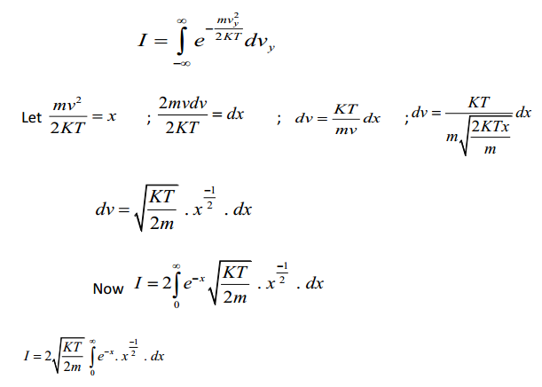

Slide 11
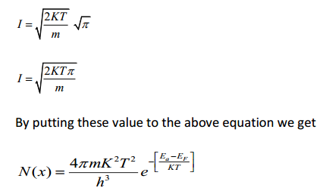

Slide 12
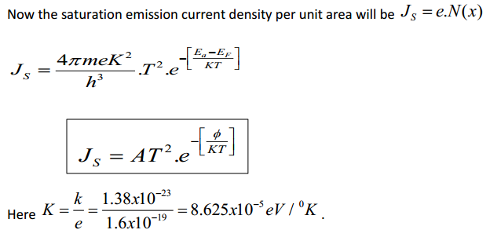

Slide 13
Contact Potential
An electrostatic potential that exists between samples of two dissimilar electrically conductive materials (metals or semiconductors with different electron work functions) that have been brought into thermal equilibrium with each other, usually through a physical contact.

Slide 14
Field Emission
The ejection of electron from the metal surface by applying very strong electric field at the surface of a metal is known as field emission.
Even at room temperature the field emission starts.
It requires millions of volts per centimeter distance between the emitting surface and the positive conductor.

Slide 15
Field Emission current density
Where

Slide 16
Secondary emission
When a very high speed electron or other particles is bombarded on the metal surface the electron emission starts.
This type of electron emission is called secondary emission.
The electron that strikes the metal surface is called primary electron and the emitted electrons are called secondary electrons.

Slide 17
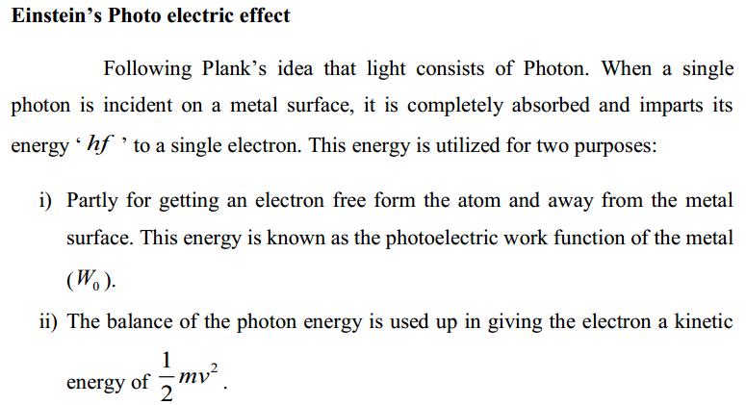

Slide 18
